Slide 1
Java script 실습
담당조교 : 송수현

Slide 2
목차
윈도우 제어
조건문과 반복문
전체 실습
과제 설명

Slide 3
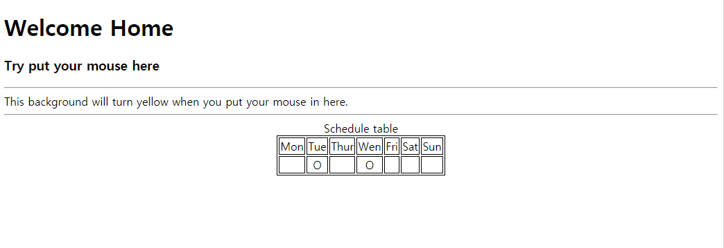
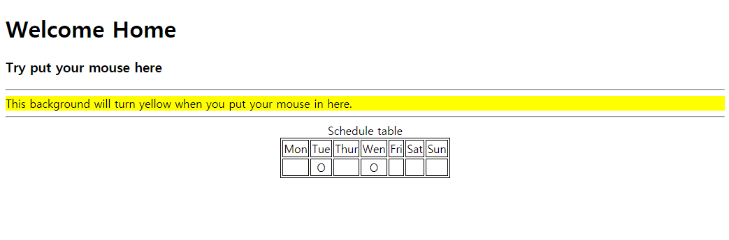
윈도우 제어

Slide 4
윈도우 제어
<!DOCTYPE html>
<html>
<head>
<script type="text/javascript" src="ex1.js"></script>
<script type="text/javascript">
//Write source code
</script>
</head>
<body >
<h3>Try put your mouse here</h3>
<hr />
<div id="content" onmouseover="highlight();" onmouseout="off();">
This background will turn yellow when you put your mouse in here.
</div>
<hr />
<div>
<script>
// Write source code
</script>
</div>
</body>
</html>
function highlight() {
// Write source code
}
function off() {
// Write source code
}

Slide 5
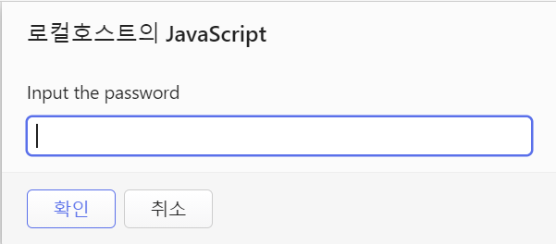
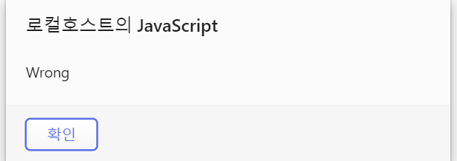
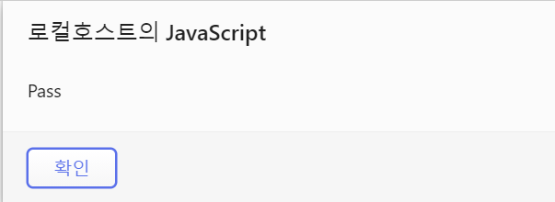
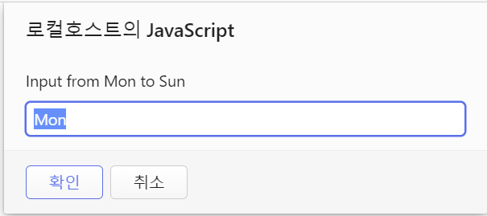
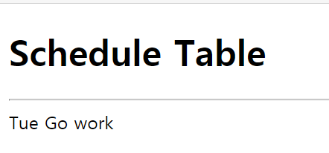
조건문과 반복문

Slide 6
조건문과 반복문
<!DOCTYPE html>
<head>
<title>Practice2</title>
<script type="text/javascript" src="ex2.js"> </script>
</head>
<body>
<script>
login();
</script>
<h1>Schedule Table</h1>
<hr />
<script>
initial();
</script>
</body>
</html>
function login() {
// Write source code
}
function initial() {
// Write source code
}

Slide 7
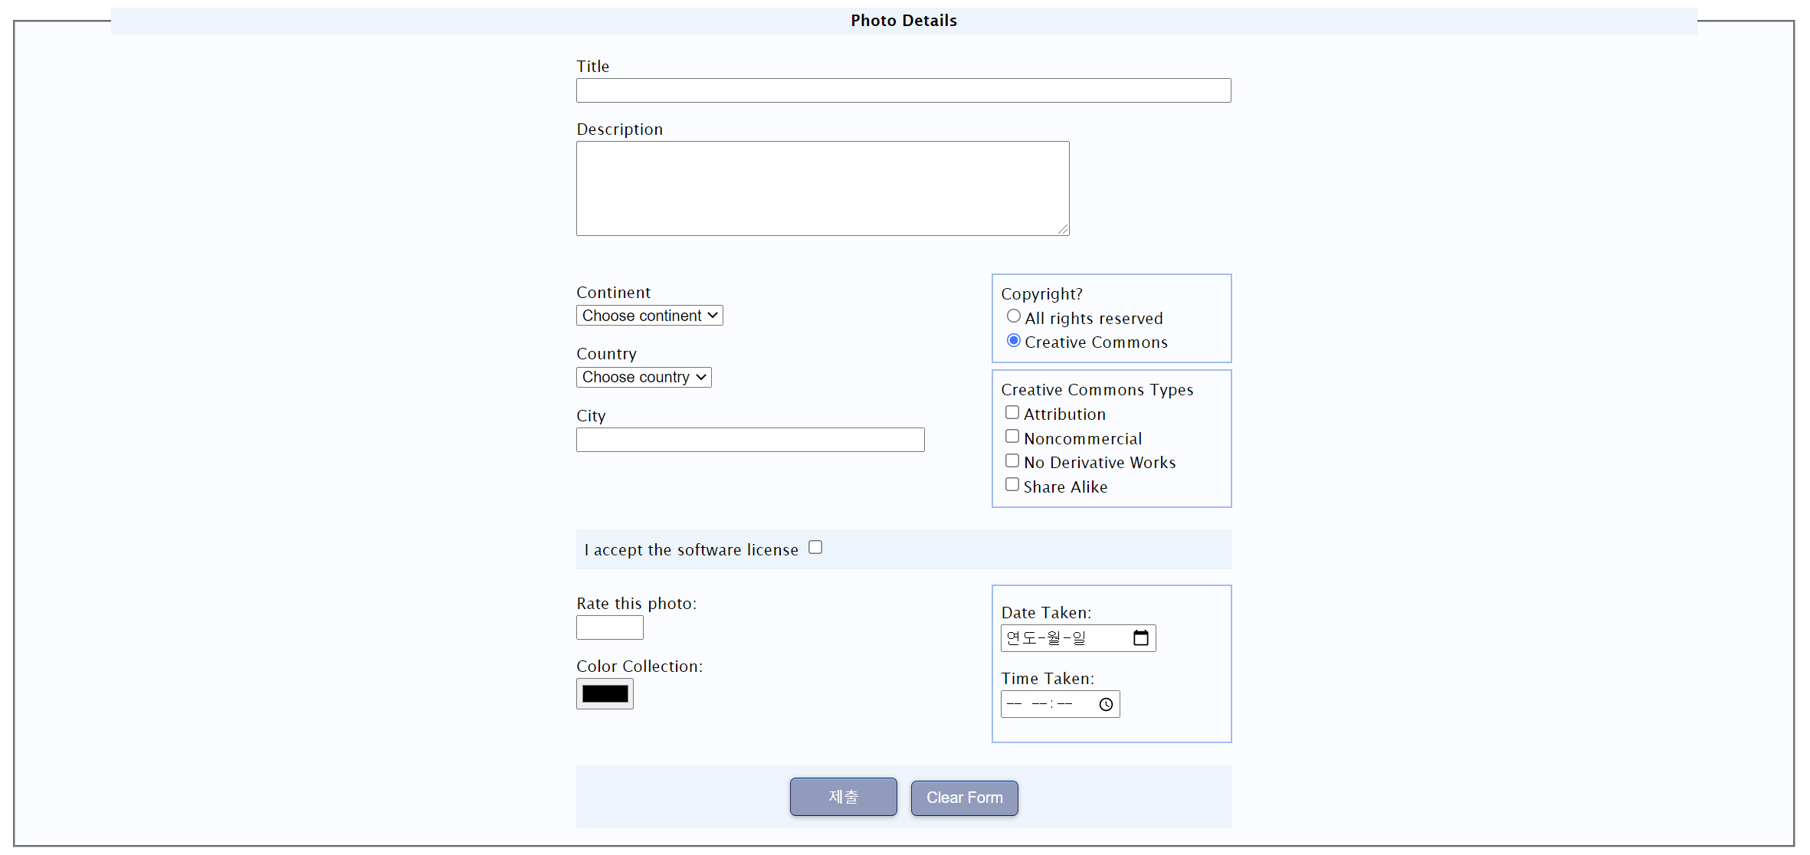
전체 실습

Slide 8
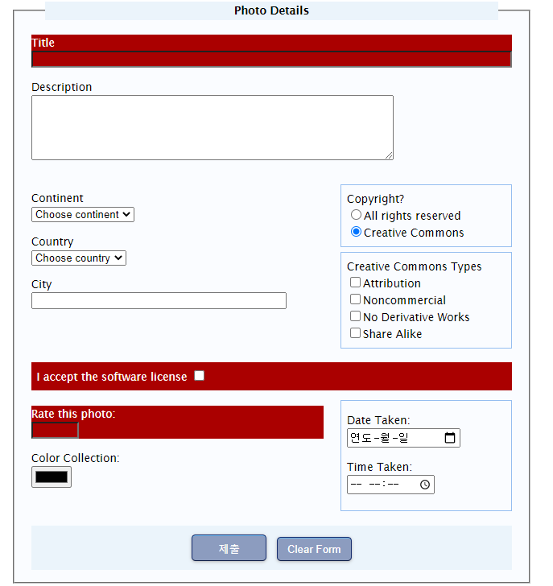
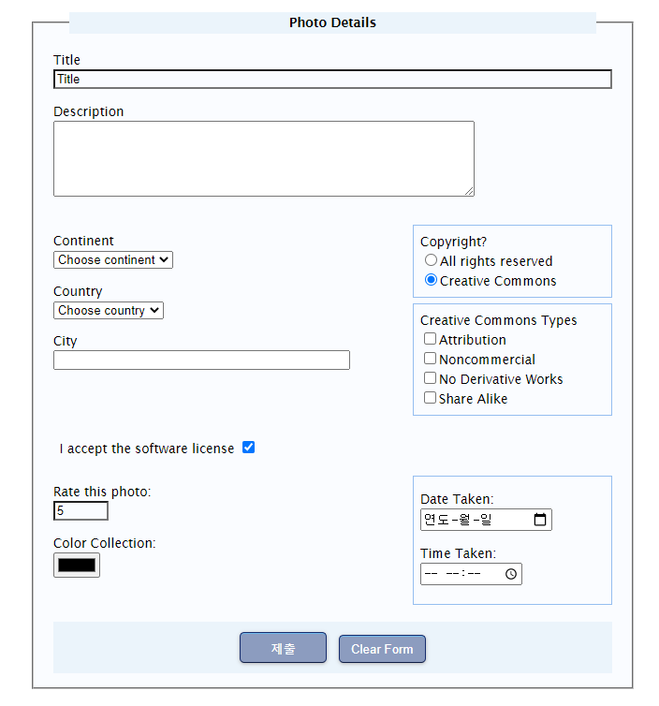
전체 실습

Slide 9
Q & A

